Slide 1

UIDAI Hackathon
Team Reference ID : LEhMvuElve
Team Member Details
Sl No | Name | E Mail ID
1 | Bhuvana Chandrika Ganti | 26bhupa@gmail.com
2 | Nikitha M | nikicm26@gmail.com
3 | Srividya H.R. | srividyahr21@gmail.com
4 | Kruthika S Vasisht | kruthikasvasisht@gmail.com
5 | Ashwini J | ashwinisamak93@gmail.com

Slide 2
About the Problem Statement
Theme 1: Address Update
Problem Statement - 03
Address Formatting Issue: Imagine you belong to the capital city of India and you reside within IIT Delhi campus. You have just enrolled yourself to the aadhaar identity platform and after successful enrolment, you have received your letter containing the aadhaar number, demographics data such as name and address. Alas, in the address field you see the repetition of ‘Delhi’ multiple times, making the address a
little convoluted. Like you, many of the residents especially those who are residing in the urban areas see the repetition of the same content in the final address.
You have to devise an innovative solution to identify repetitive content (like Delhi
in the instant use case) and merge it in a manner that the overall address remains intact
and usable. The solution must comply with the following:-
Essential fields like District and State can be merged into a single entity.
If the repetitive text is a subpart of a field, then merger should be avoided.
For example, ‘Purani Delhi’ as locality and ‘Delhi’ as State can’t be merged.
An API is to be developed which will take the address in its raw form as
input and optimized/formatted response should be the output. No user interface
would be required.
Bonus credit would be given to the team who can also consider the
address in the local language and optimize the same.
You can use any open-source technologies to demonstrate the solution.

Slide 3
Approach
We are developing an API that can be used to format the address with repetitive data
We will be using a dictionary to store address fields as keys and the data related to that particular address field as values.
The address in the raw format is stored into a dictionary where the values of each key is compared to one another and:
Special characters are not considered while comparing the values.
Minor spelling mistakes are also ignored while they are compared in case of address in English language.
Duplicate data is made null.
The resulting dictionary is returned, which gives the formatted address in the form of JSON Object.

Slide 4
Architectural Diagram
Address
(raw data input in English)
Store in Dictionary
Return the formatted address
Delete duplicates from dictionary

Slide 5
Steps for execution:
Download all files from https://github.com/AshwiniJagadeesh/Address-Formatting-API/blob/main/README.md
You will find two folders, the apiKeyAuth folder is a project that makes use of API key for authentication.The basicAuth folder is a project that makes use of basic authentication,ie., username and password for authentication.

Slide 6
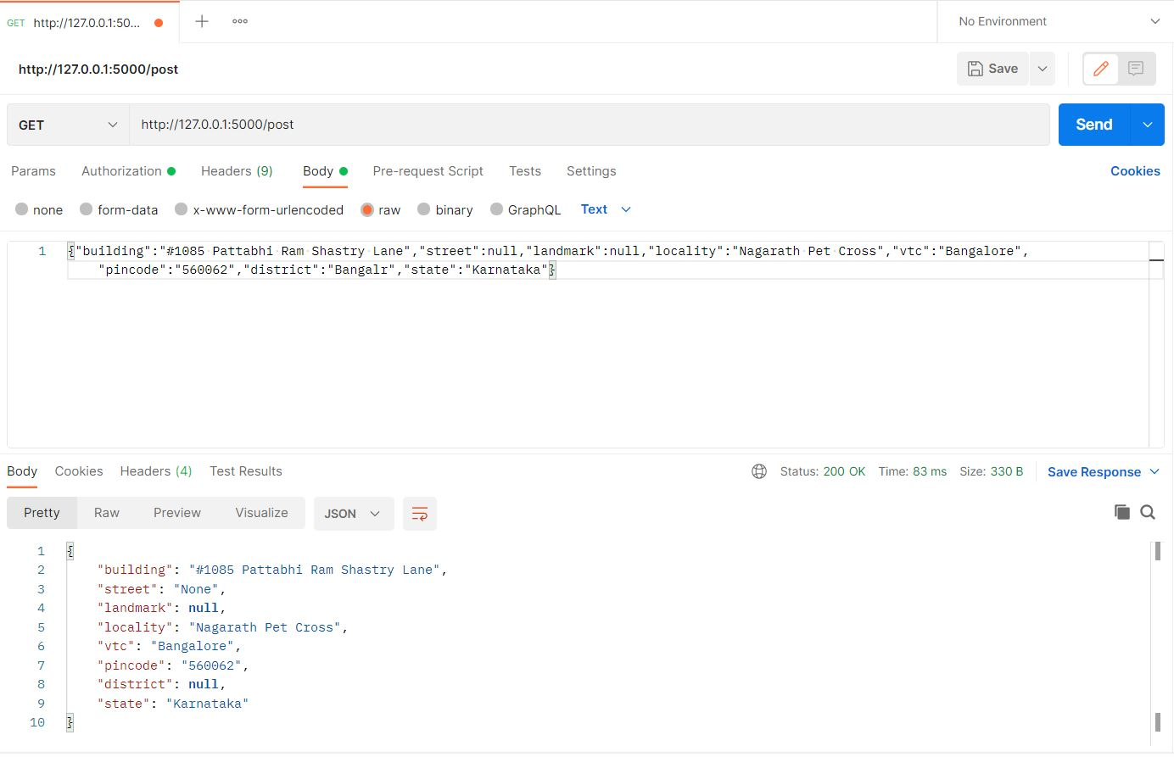
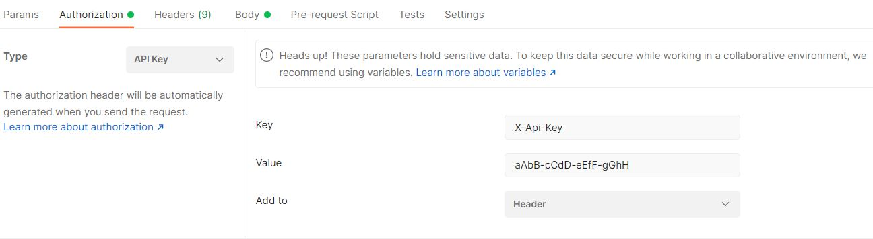
Run auth.py from the apiKeyAuth folder.You will get a url which has to be copied to Postman Application and make changes to the url,
Add the address in the body as well in the json format.
Add the API key and value as shown below.Click send.

Slide 7

You will get the formatted address with the required changes as shown below

Slide 8
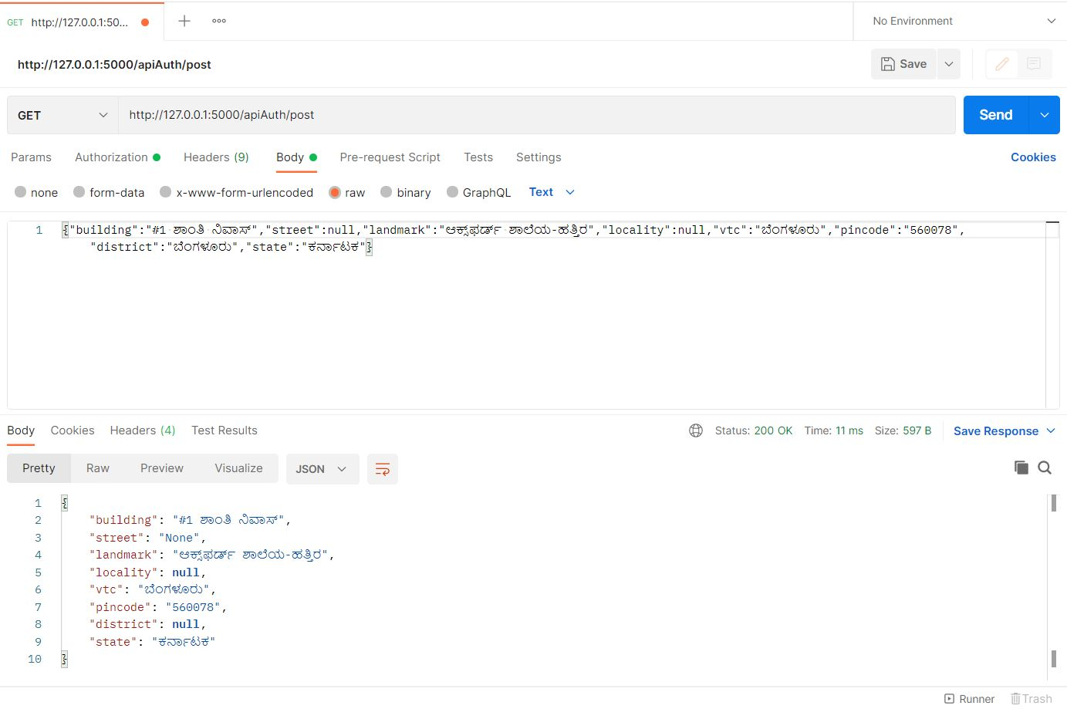
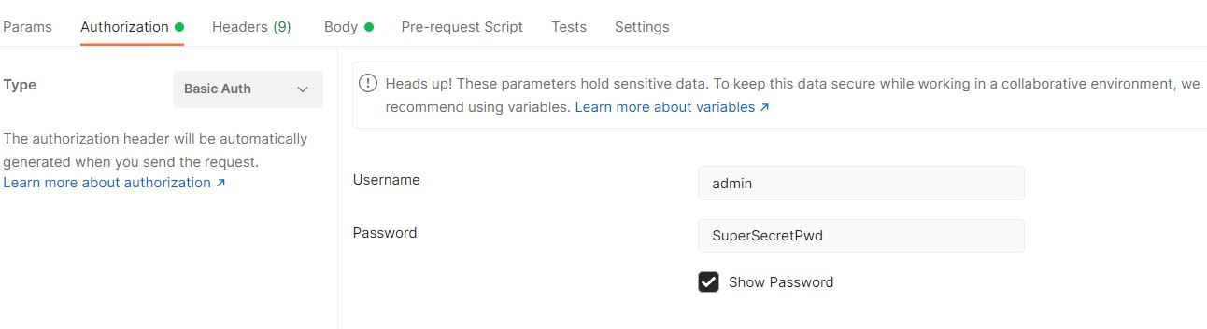
Run auth.py from the basicAuth folder.You will get a url which has to be copied to Postman Application and make changes to the url,
Add the address in the body as well in the json format.
Add the username and password as shown below.Click send.

Slide 9
You will get the formatted address with the required changes as shown below.

